Slide 1
Canteen Vendor Management System
A reliable system to find suitable vendor for you!

Slide 2
Team Members
Bitu Roy - 0112310176
Durjoy Chandra Das-0112310177
Abir Korashi Symum - 0112330396
Mst. Esrat Ansary - 0112330477
Abdullah Al Galib - 0112330480

Slide 3
Short Description
A web-based platform where university authorities or the canteen committee select vendors through a transparent, data-driven process. Vendors submit proposals (pricing, menu, hygiene) while students provide ratings and reviews. The system includes meeting management, performance dashboards, analytics, and notifications ensuring quality food, fair selection, and active student involvement.

Slide 4
Motivation
This project aims to solve these problems by introducing a transparent, fair, and data-driven system. It will:
Improve food quality and service
Ensure fair vendor selection
Allow students to share real feedback
Help authorities make better decisions using data

Slide 5
Scopes
Features
Authority Tools
Vendor Registration & Profile
Vendor Selection & Evaluation
Student/Faculty/Staff Review & Rating
Meeting & Interview Scheduling
Notification System
Role-Based Access Control
Food Item(s) Wishlist Integration
Anonymous Student Voting
Event-based Vendor Selection
Student Participation: Ratings, reviews, and complaints integrated into vendor performance monitoring.
Authority Tools: Meeting scheduling, dashboards, analytics, and notifications for transparent decision‑making.
Expansion To Multiple Venue(s): Planned to expand to corporate offices, hospitals, malls, hostels, and events for managing vendors, feedback, and food quality.

Slide 6
Tools
Backend:
Language: Java
Database: PostgreSQL
Auth: JWT + OAuth (Google)
Frontend:
Framework: React.js with Tailwind CSS
Charts: Chart.js
DevOps:
Development: Docker, Nginx
CI/CD: GitHub Actions
Monitoring: Sentry / Prometheus

Slide 7
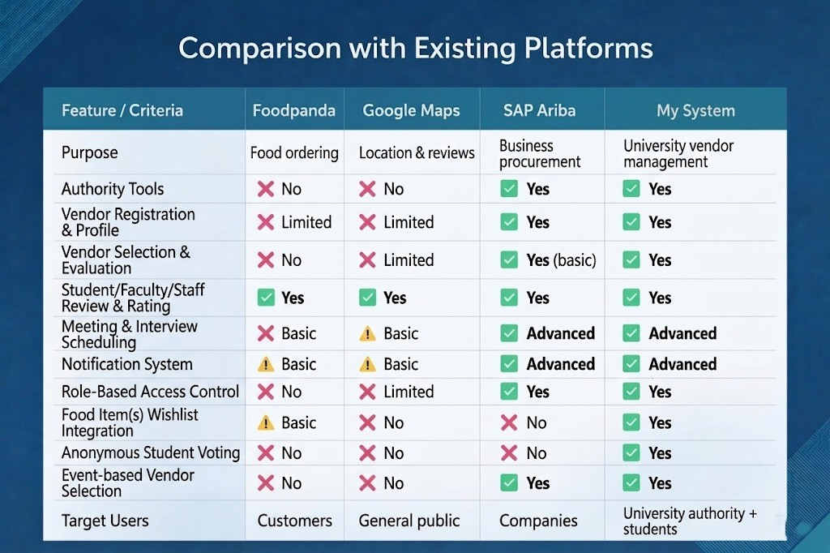

Slide 8
Thank You

